Slide 1
MANUFACTURER OF
VEGETABLES DEHYDRATION PLANTS AND MACHINE
APS INDUSTRIES
8238550555 9409150555

Slide 2
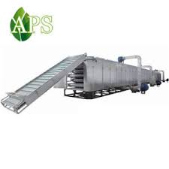
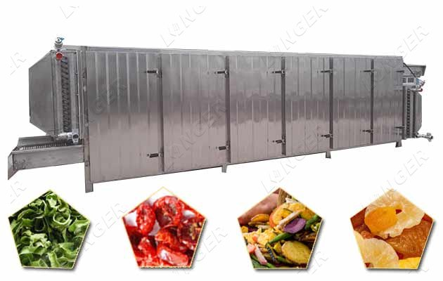
APS INDUSTRIES
VEGETABLE DEHYDRATION
MACHINE
8238550555 9409150555

Slide 3
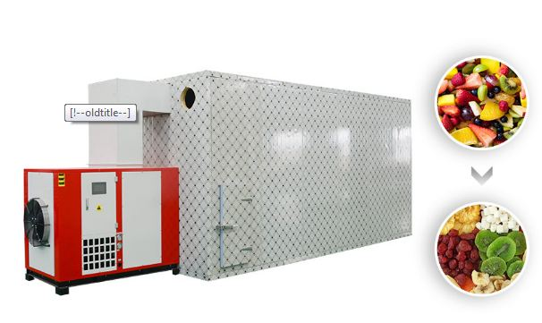
APS INDUSTRIES
FRUIT DRAYER
MACHINE
8238550555 9409150555

Slide 4
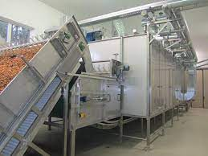
APS INDUSTRIES
Garlic
Dehydration
8238550555 9409150555

Slide 5
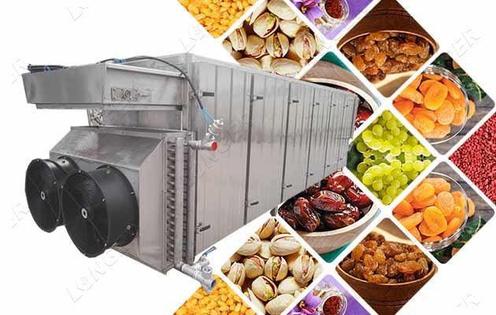
8238550555 9409150555
Fruit Dehydration machine

Slide 6
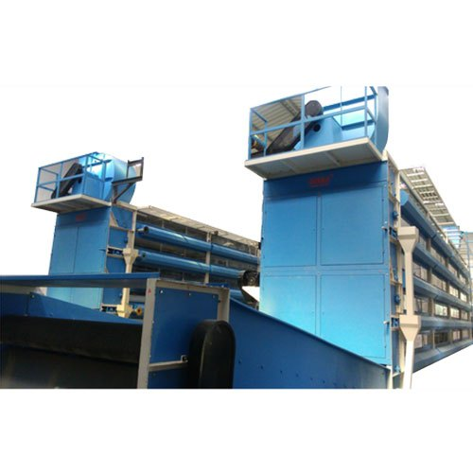
Ginger Dehydration Machine
8238550555 9409150555

Slide 7
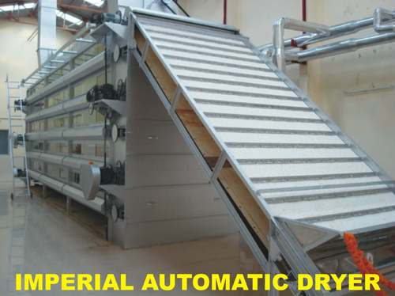
8238550555 9409150555
Onion Dehydration machine

Slide 8
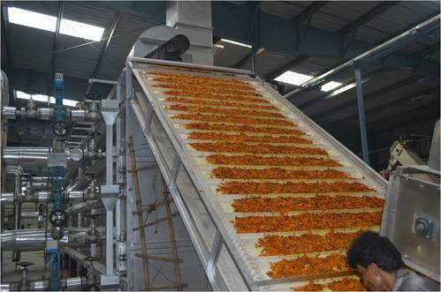
Orange
Dehydration
Machine
8238550555 9409150555

Slide 9
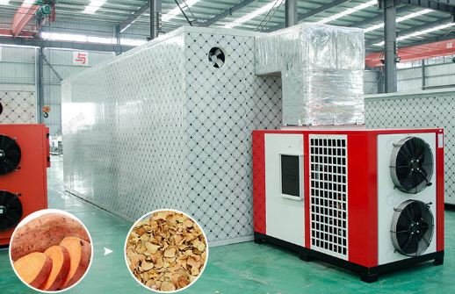
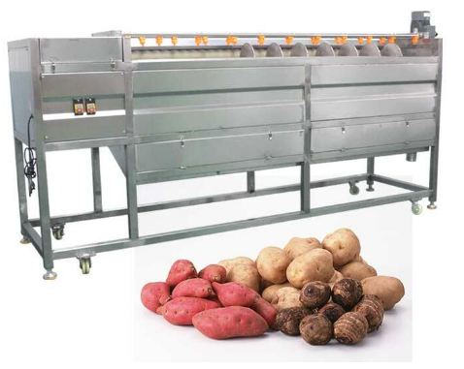
Sweet Potato
Dehydration
Machine

Slide 10
APS INDUSTRIES(Ahmedabad)
Call Now
7046650555
Visit Us
www.foodprocessingmachine.video

