Slide 1


Ahmedabad ,Gujrat
Welcome to
Aps
Industries

Slide 2

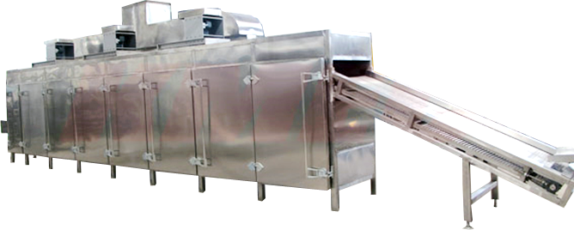

VEGETABLES
DEHYDRATION MACHINE

Slide 3


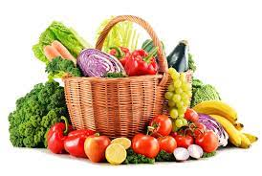
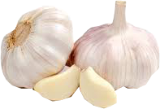
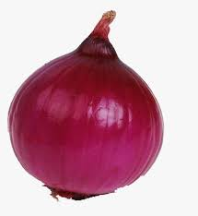
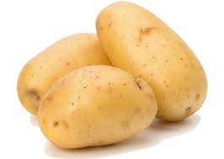

Start with ALL VEGETABLES & FRUITS
Garlic,Potato
Onion ,Ginger

Slide 4

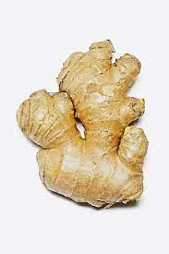
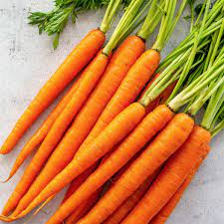
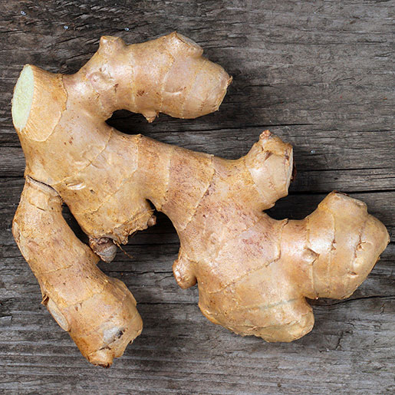
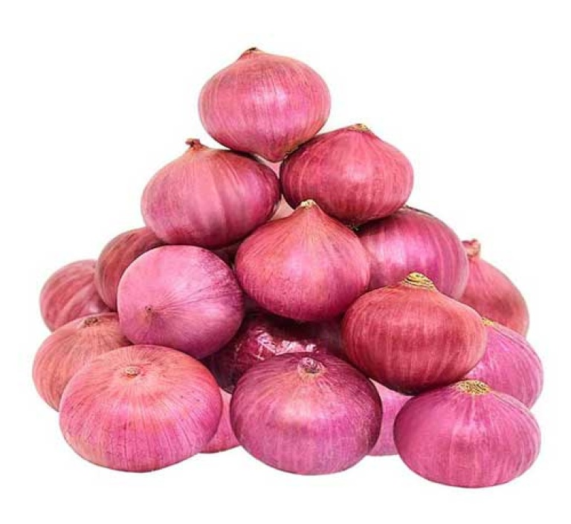
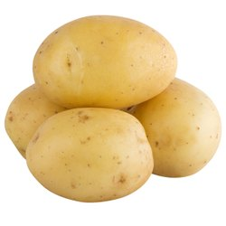
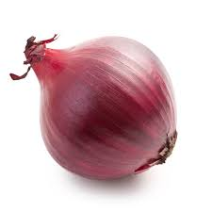

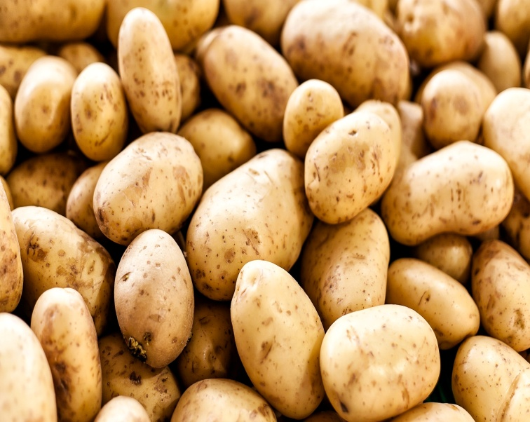
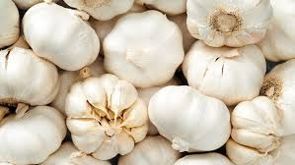

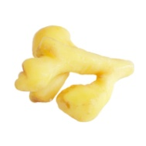

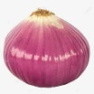


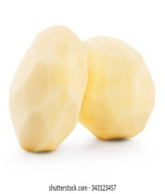


VEGETABLE PEELING MACHINE
Peeled ginger
Peeled onion
Peeled Potato

Slide 5
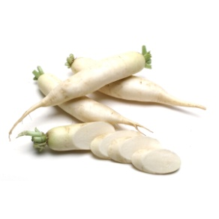
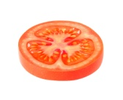
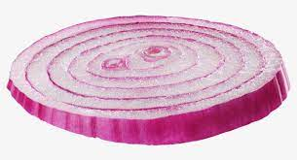
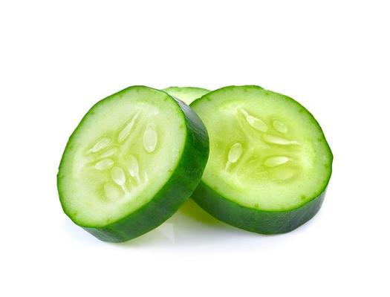
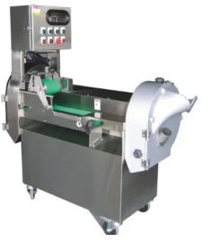

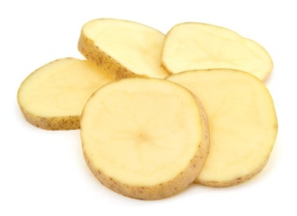
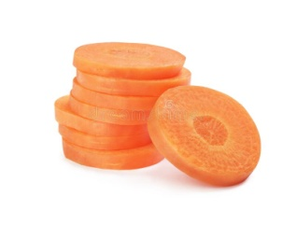
Vegetable Cutting Machine
Radish Slie
Tomato slice
Onion slice
Cucumber slice
Potato slice
Carrot slice
Multi Vegetables Cutting Machine

Slide 6



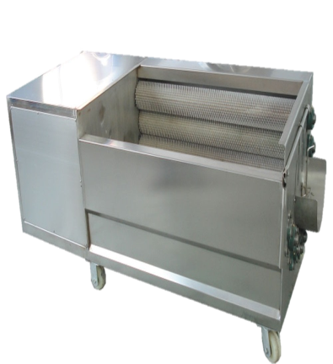

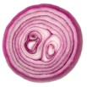
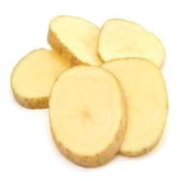
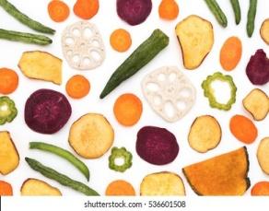
Vegetable dehydration process
Vegetables
-
VEGETABLE PEELING MACHINE
VEGETABLE CUTTING MACHINE
VEGETABLE DHYDRATION MACHINE

Slide 7
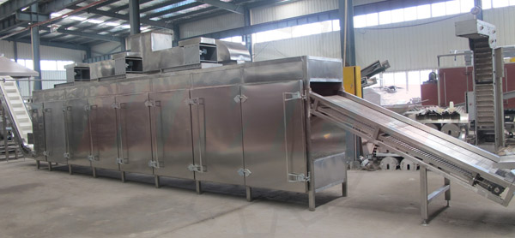
Vegetable Conveyor (Dehydration Dryer) Machine
Dehydrated vegetable dryer, which consists of belt conveyor, blanching and scalding machine, vegetable washer, automatic feeder machine, the dryer, coal hot blast heater, transmission and control system, is a series product and Automatic continuous system drying equipment.
APS Industries APS Industries APS Industries
APS Industries APS Industries APS Industries
APS Industries APS Industries APS Industries
APS Industries APS Industries APS Industries
APS Industries APS Industries APS Industries
APS Industries APS Industries APS Industries
APS Industries APS Industries APS Industries
It can be used for drying Vegetables, Medicinal materials and fruits of cabbage, carrot, cucumber, pumpkin, cassava slice, green sword bean, garlic bolt, Chinese medicinal crop slice, ginger slice, green Chinese onion, bamboo shoots, and the rhizome, rhizome stick and rhizome leave of them; also the fruits of areca-nut, date, grape, apple slice and kiwi fruit slice

Slide 8
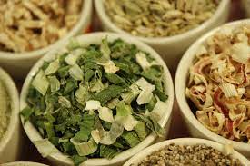
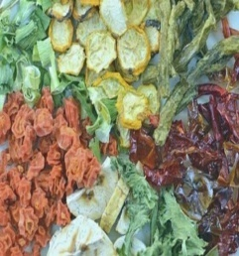

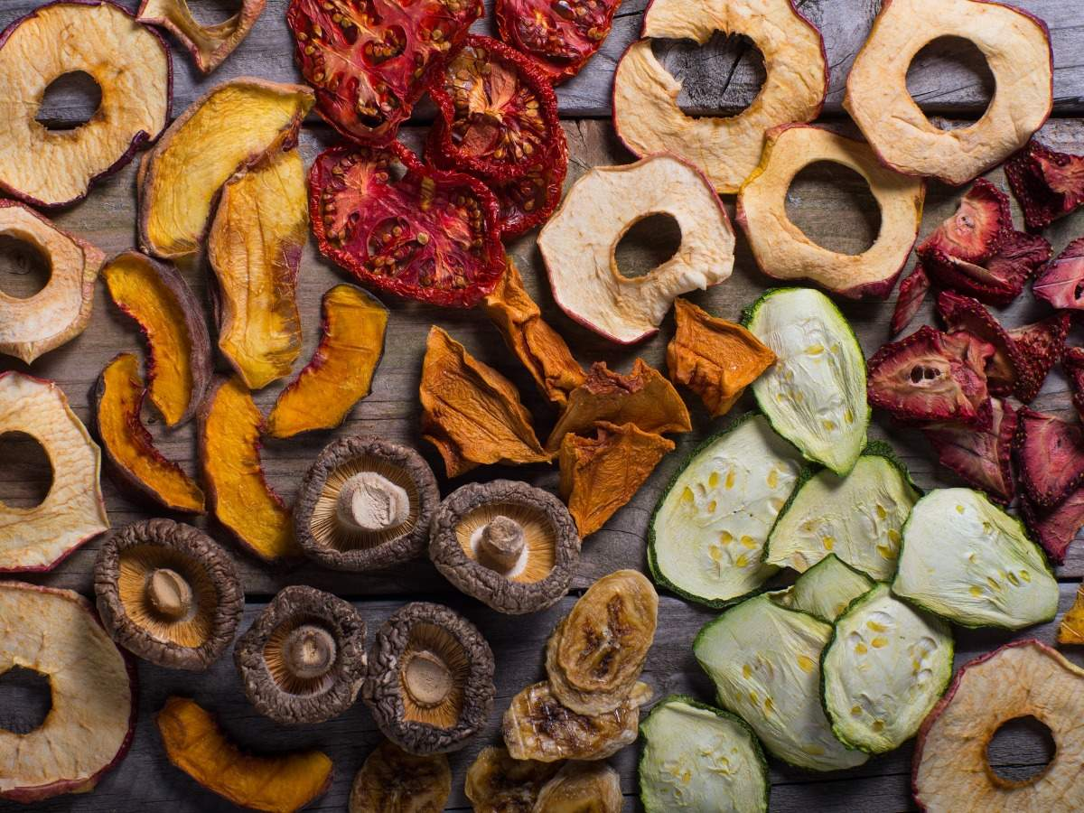

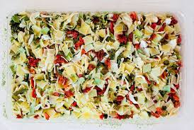
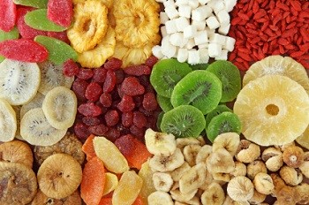
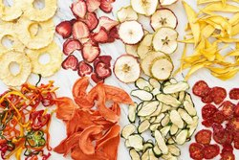
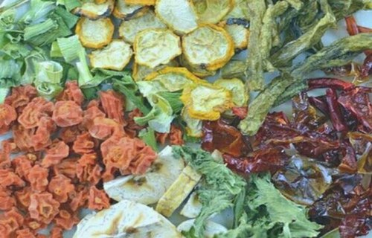
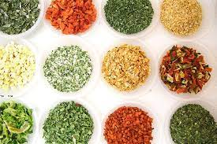

Dehydrted VEGETABLES
Vegetable Conveyor (Dehydration Dryer) Machine

Slide 9

APS INDUSTRIES
ALL TYPE FOOD PROCESSING MACHINE MANUFACTURER
Thank you for Watching

